Slide 1

Group 5 Movie Analysis
Manoj Kashyap
Sai Krishna mogallapu
Katie Oertel
Inderdeep Singh

Slide 2


TARGET AUDIENCE:
Production Companies

Slide 3
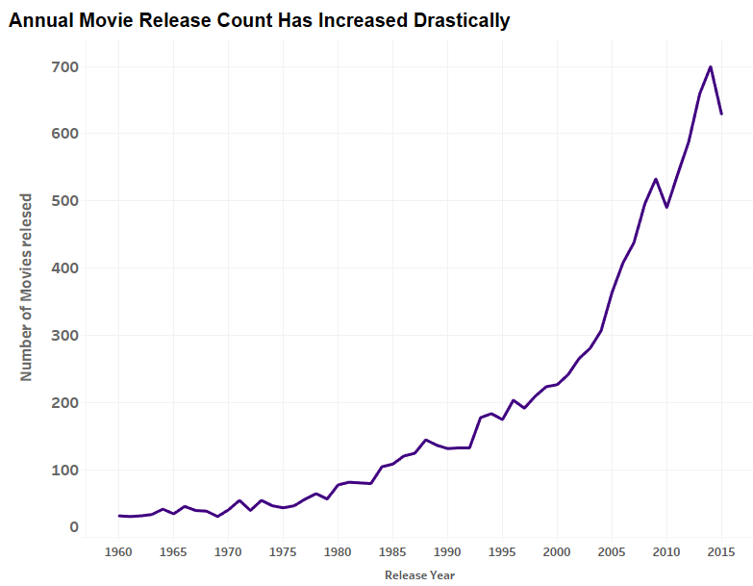
Overview

Slide 4
Top Questions:
What is the highest performing/popular genre of movies and is there an ideal runtime?
Is there a certain cast member or director that brings in higher profits?
How’s the financial growth of the industry and is there an ideal time of year to release a movie?

Slide 5
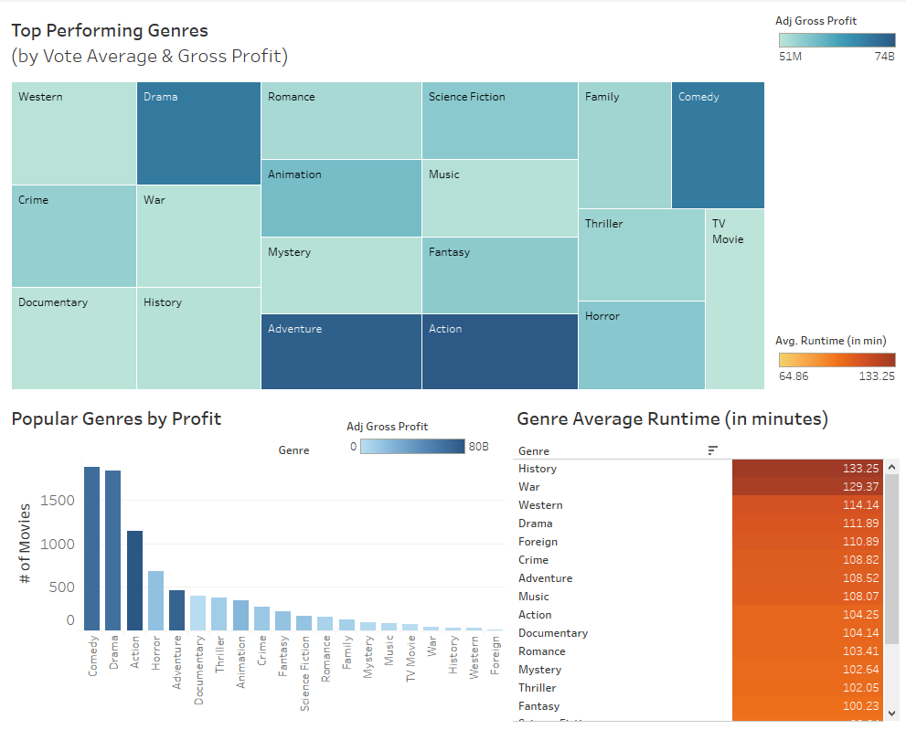
Key Insights
Action, Adventure, Drama and Comedy movies have the highest adjusted profit
Comedy and Drama are the most commonly produced
History & War movies run longer on average

Slide 6
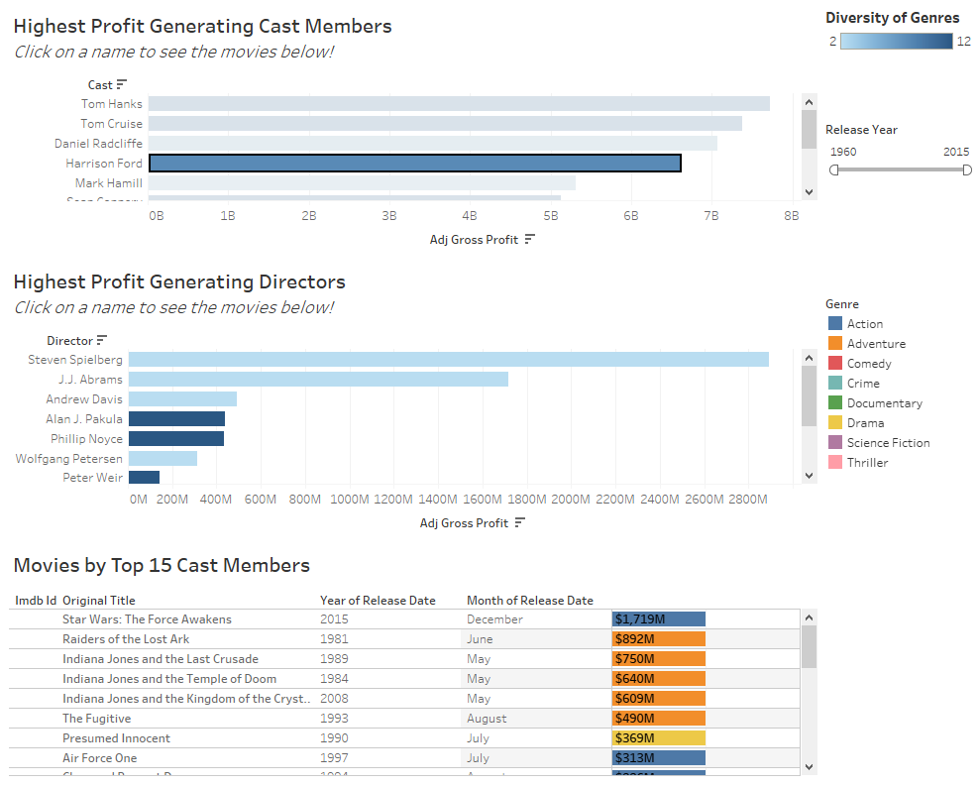
Key Insights
Most high performing actors are diverse, meaning they perform in many genres
Interactive dashboards like this allow the user to drill down into an area of interest

Slide 7
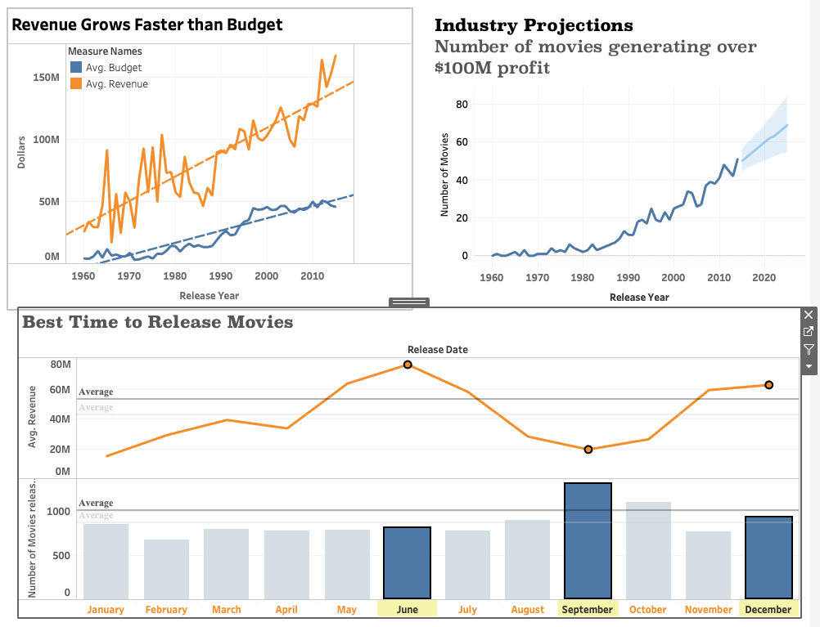
Key Insights
In 2014 there was a record number of 51 movies that made a profit over $100M
The industry is growing strong, as shown by the average revenue outpacing the rate of average budget
Fewer movies released in June and December yet highest revenue

Slide 8
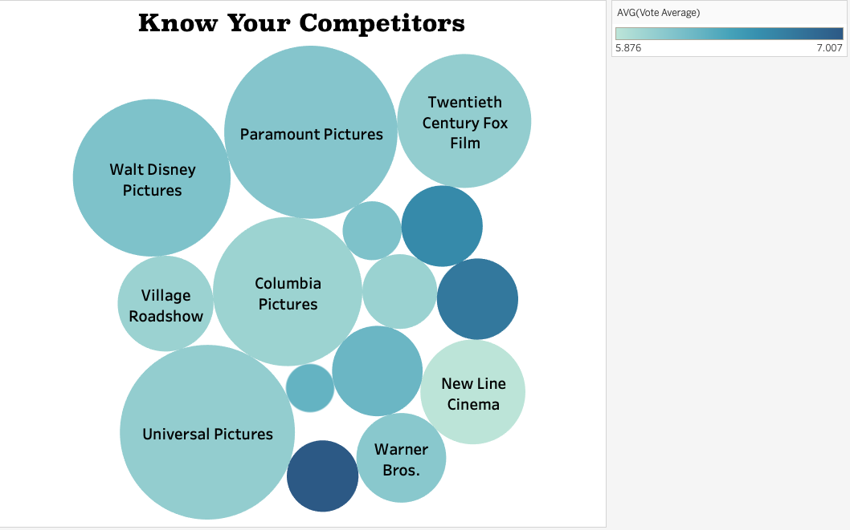
Top Competitors

Slide 9
Conclusion
Know what kind of movie you want to produce
Book call sheets of good directors and cast members
Produce a great movie, you are about to make your mark in the industry with record profits

Slide 10

Questions?

